Slide 1
Lec - 3

Slide 2



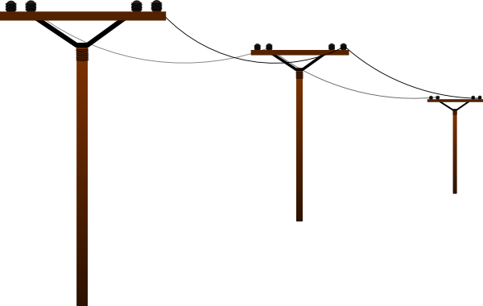
Transformation of energy in an electric generator using wind energy
Blades
Wind
Shaft
Electric Generator
N
S
Armature
T₁
T₂
Terminal T₁ & T₂

Slide 3
Blades
Shaft
Gear
box
Air
Generator
Shaft
Bearing
Support

Slide 4
Wind
N
S
T₁
T₂

Slide 5
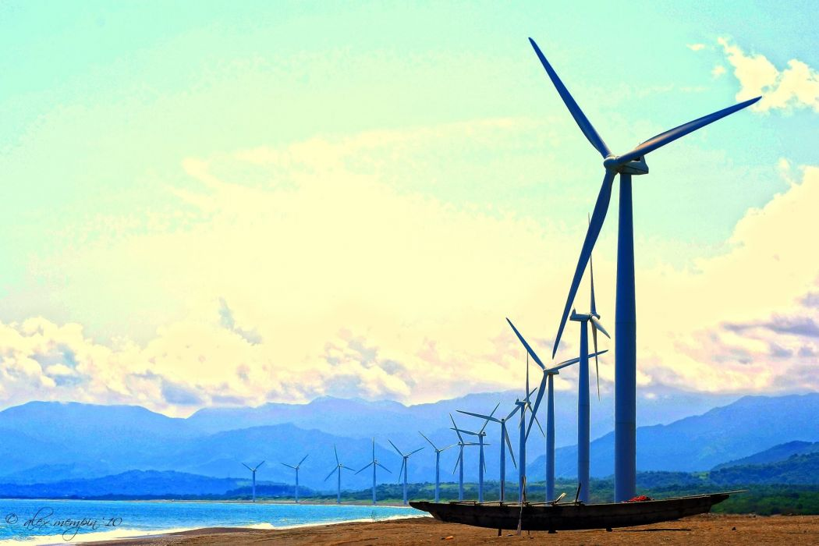
Stages in electric generator using wind energy
More than 15km/h
Wind with
required velocity
Wind Turbine
with large fans
Electrical energy
Generator
Transformation of energy in an electric generator using wind energy
Kinetic energy in wind
Kinetic energy in turbine
Electrical Energy

Slide 6
Production of Electricity from Wind Energy
ADVANTAGES :
Wind
Does not cause any pollution.
Renewable source of energy.
LIMITATION :
Wind energy farms cannot be established everywhere.
N
S
T₁
T₂
Expensive

Slide 7
Production of Electricity from Wind Energy
Wind
Mention some limitations of harnessing wind energy.
N
S
T₁
T₂

Slide 8


Q.
How has the traditional use of wind and water energy been modified for our convenience?
Ans:
Traditionally, waterfalls were used as a source of potential energy in which water is allowed to fall on the blades of the turbine and the rotatory motion of the blades is converted into electrical energy.
But waterfalls are few in number therefore water dams have been constructed.
Nowadays, hydroelectric power stations are used in order to harness potential energy of stored water.
Earlier, the windmills were used to harness wind energy to do mechanical work such as lifting or drawing water from a well.
But nowadays, windmills are used to generate electricity.

Slide 9

RENEWABLE
SOURCES OF ENERGY
A natural source providing us energy continuously is called a renewable (or non-conventional) source of energy.
1
Sun
2
Tides
Sun is the main source of energy for us on the earth.
3
Oceans
4
Wave
5
Geothermal
6
Nuclear fuel

Slide 10
SUN AS
SOURCE OF ENERGY
Sun is the main source of energy for us on the earth.
THE ENERGY OBTAINED FROM SUN IS CALLED THE SOLAR ENERGY.

Slide 11
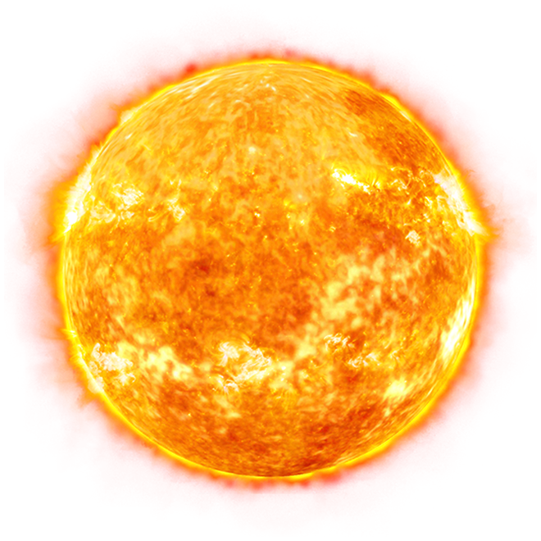
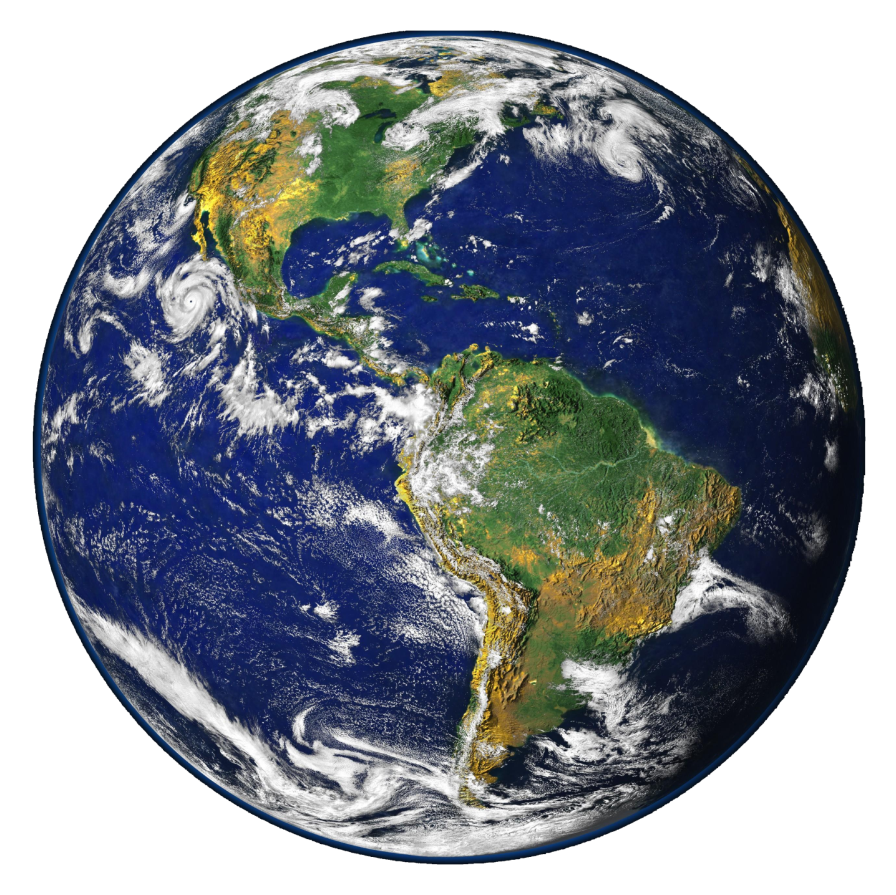
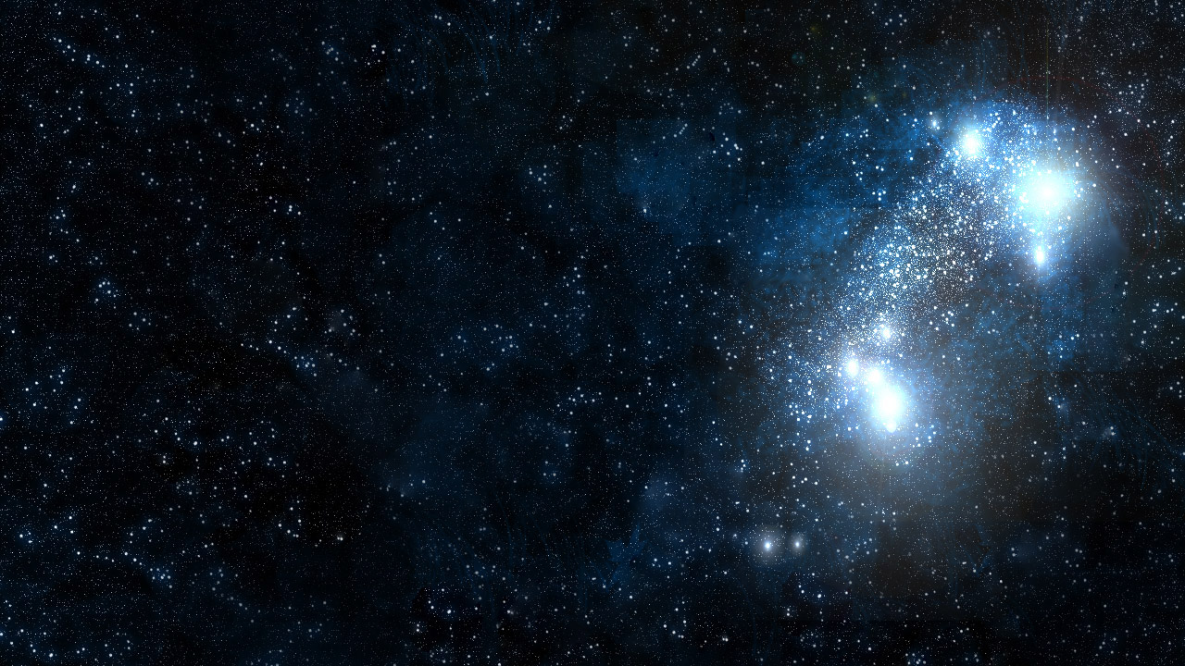
On earth, the energy received from the sun is utilized in different ways
56 - 60%
Absorbed by
the atmosphere
10%
Utilized in heating of water and land
8%
Falls on plants

Slide 12
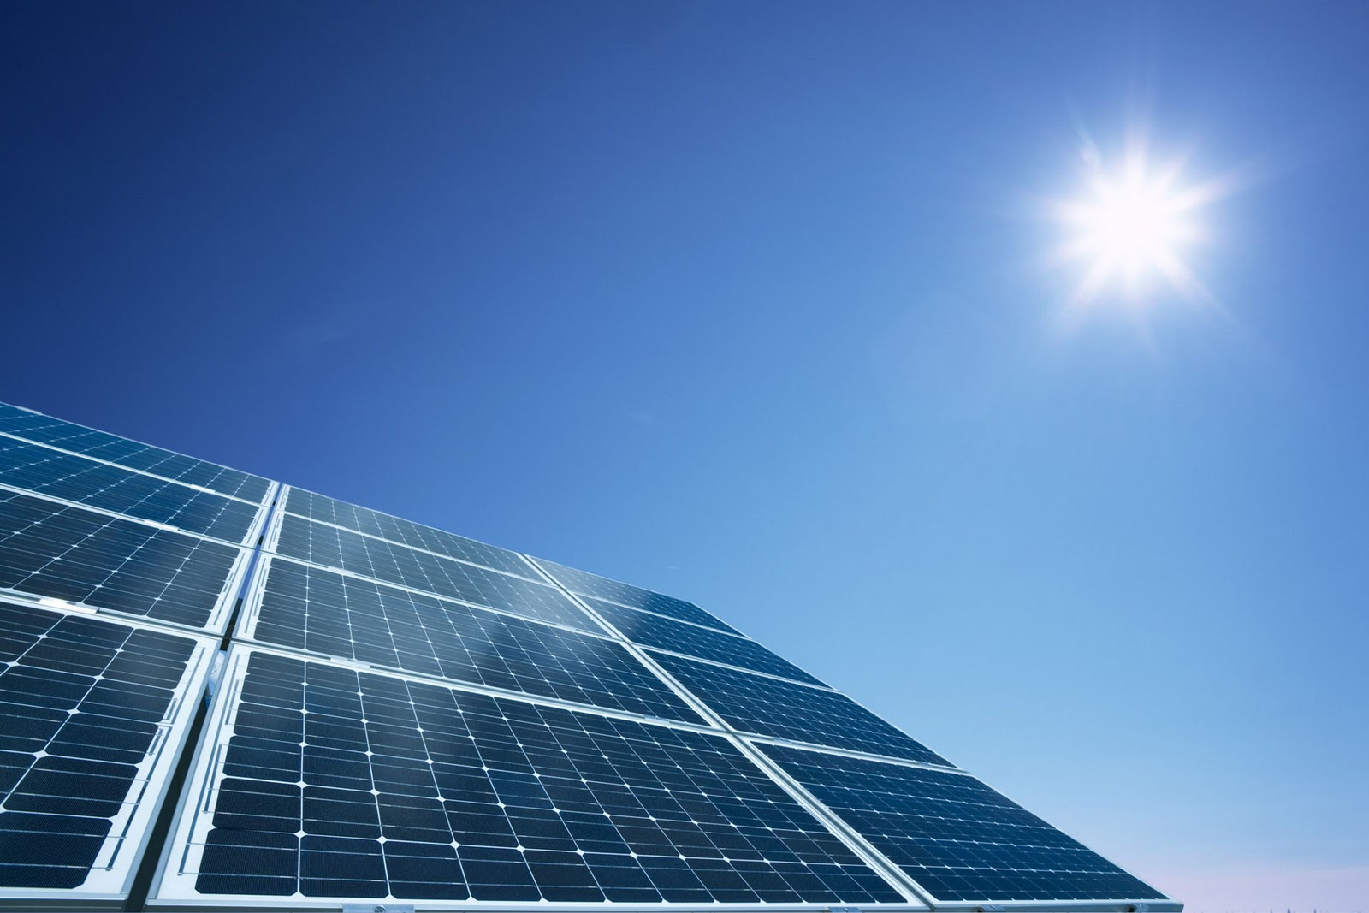
PRODUCTION OF ELECTRICITY FROM
SOLAR ENERGY

Slide 13


SOLAR COOKER
For cooking it requires slow heating i.e. about 100°C - 140°C.
MIRROR
GLASS LID
The inner surface is black because 98% of heat is absorbed by black colour.
COOKING POTS
INSULATED BOX
What kind of mirror – concave, convex or plain – would be best suited for use in a solar cooker? Why?

Slide 14
Q.
What are the advantages and limitations of solar cooker?
Ans:
Advantage :
Does not use fuels like coal, kerosene and LPG.
No smoke.
Since the food is cooked at a comparatively lower temperature in a solar cooker, its nutrients do not get destroyed.

Slide 15
Q.
What are the advantages and limitations of solar cooker?
Ans:
Limitations :
Cannot be used during night time and cloudy days.
The direction of the mirror of the solar cooker has to be changed from time to time to keep it facing the sun.
It cannot be used for baking (making chapatis, etc) and frying.

Slide 16
Thank You

